Slide 1

Our Journey Is Our Reward
by John Driscoll
JTD Energy Services PTE LTD
Singapore

Slide 2
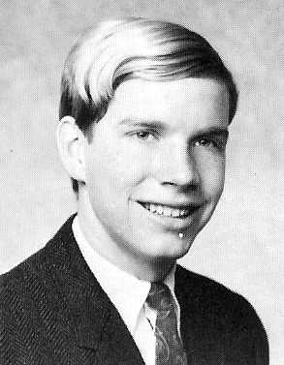

Slide 3
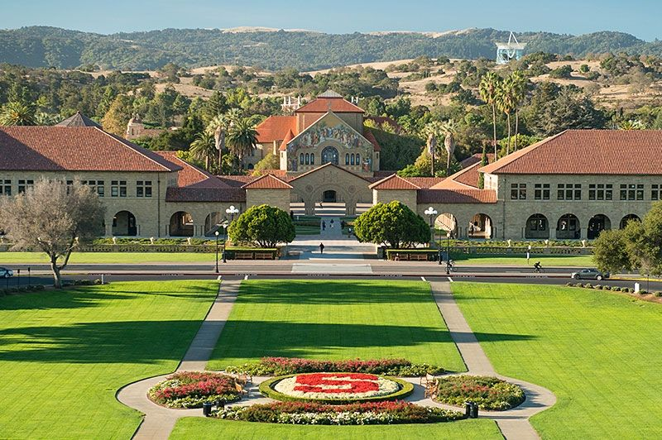

Slide 4
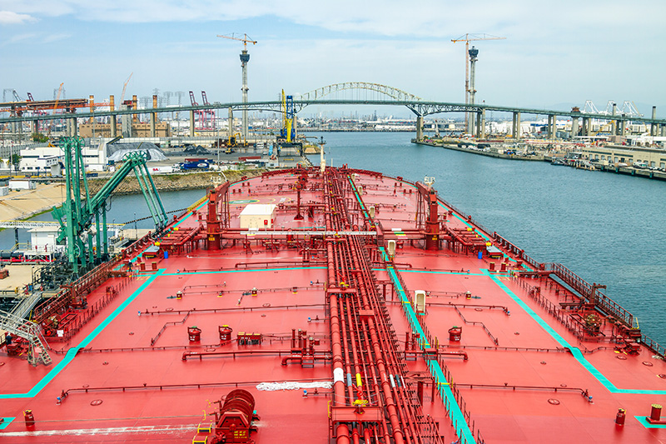

Slide 5


Slide 6
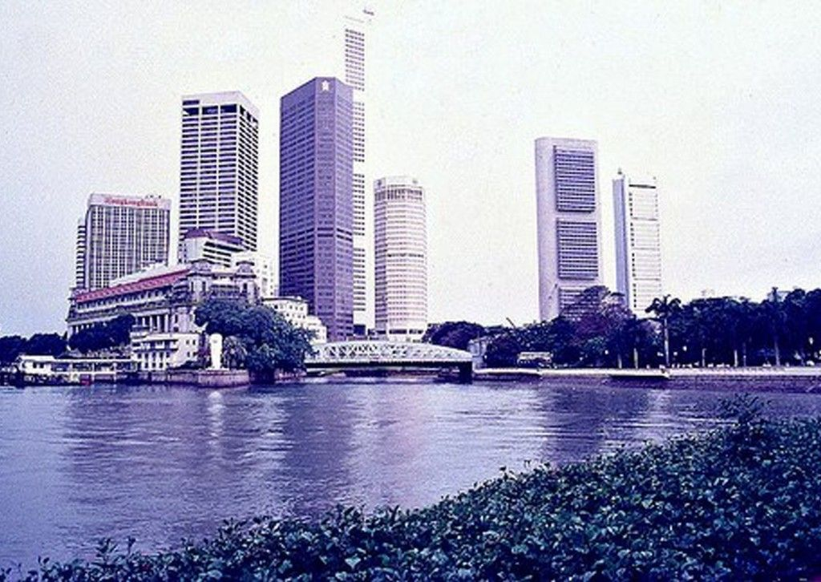

Slide 7
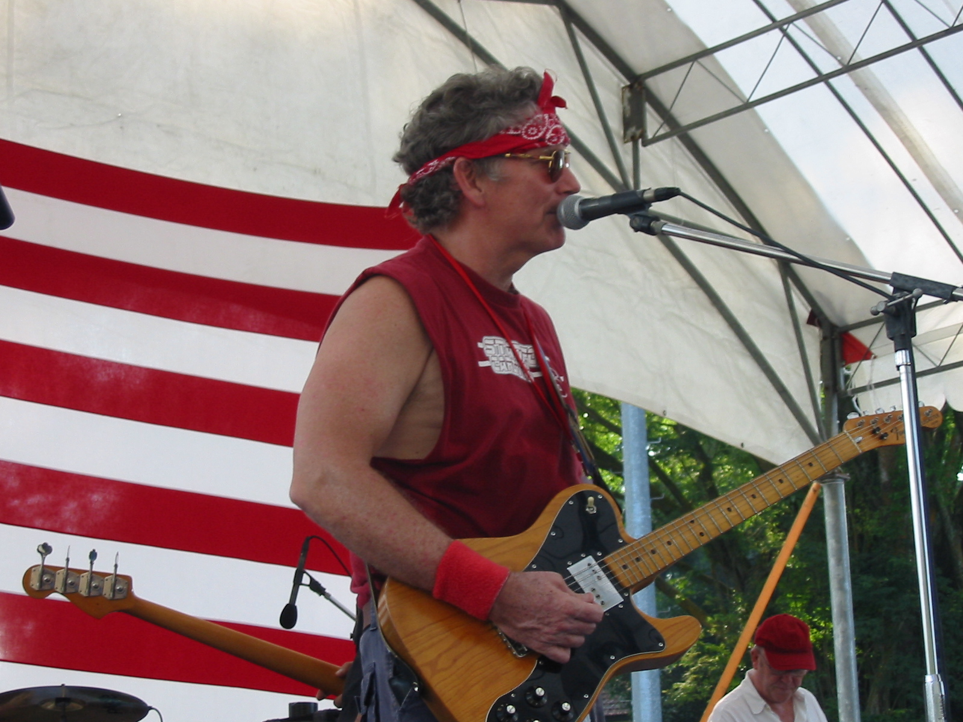

Slide 8
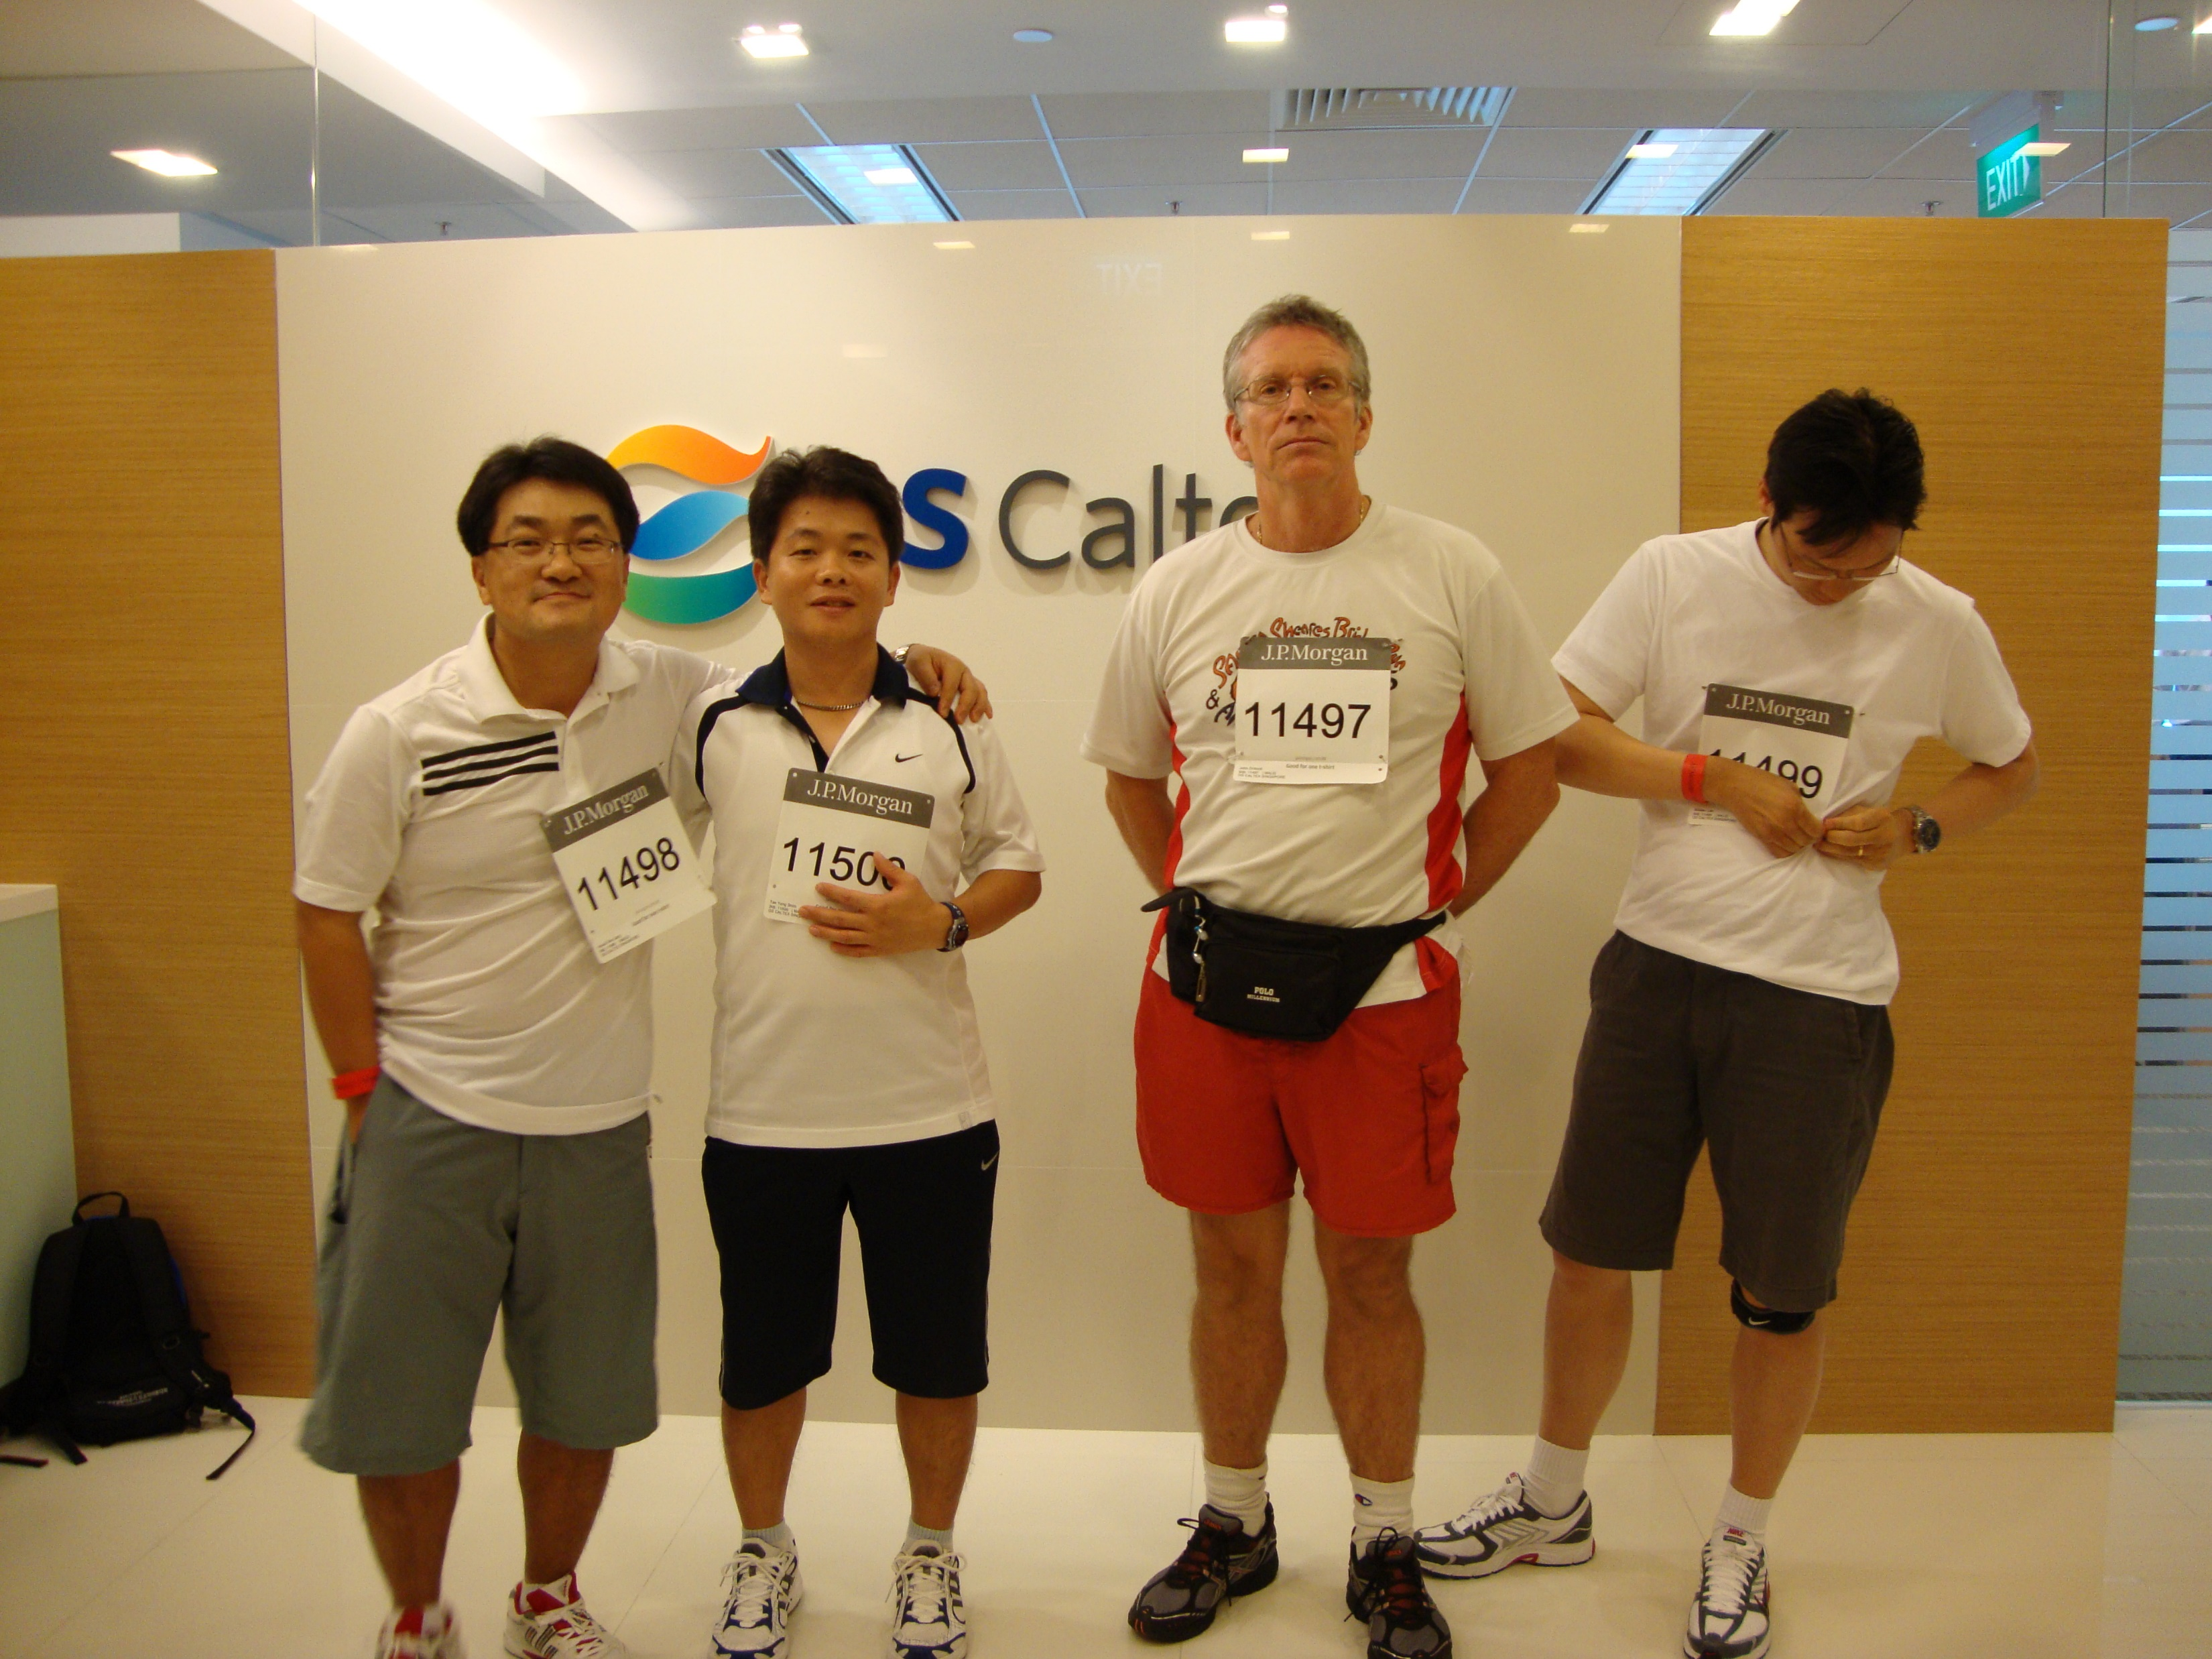

Slide 9


Slide 10
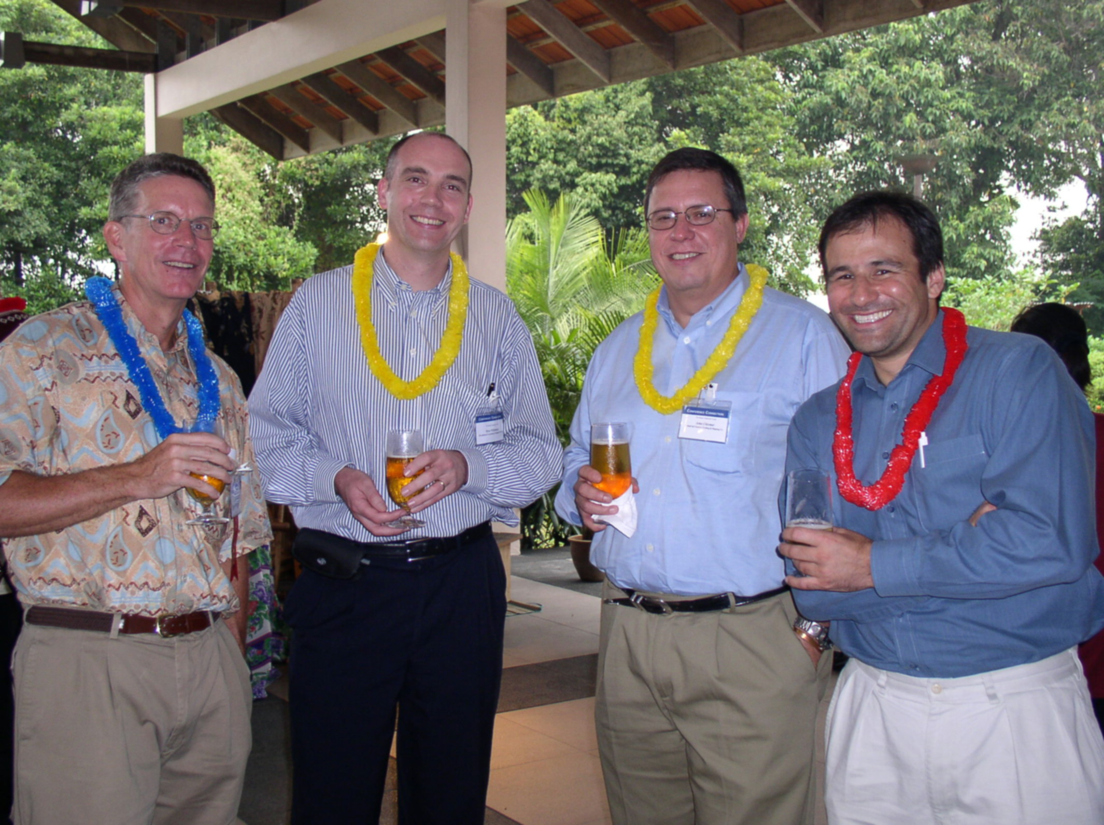

Slide 11
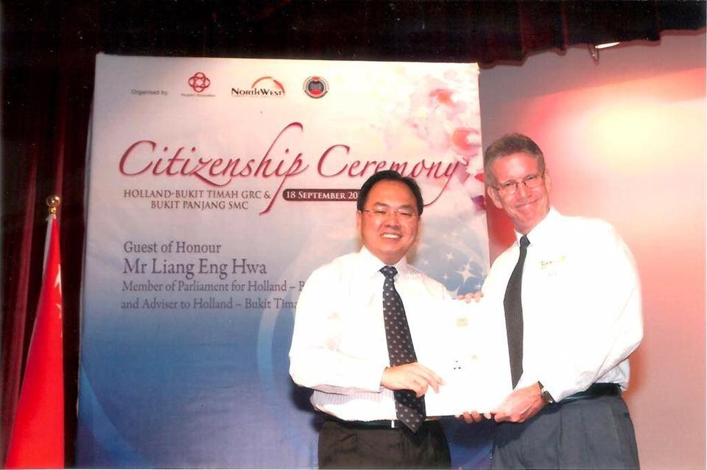

Slide 12


Slide 13
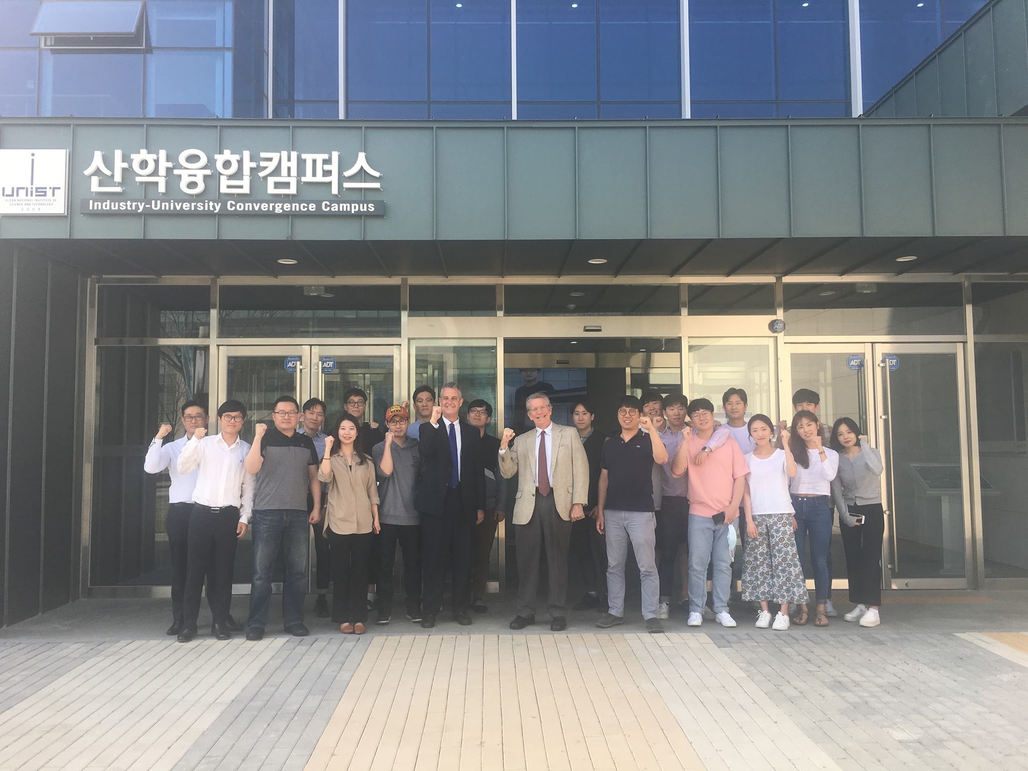

Slide 14
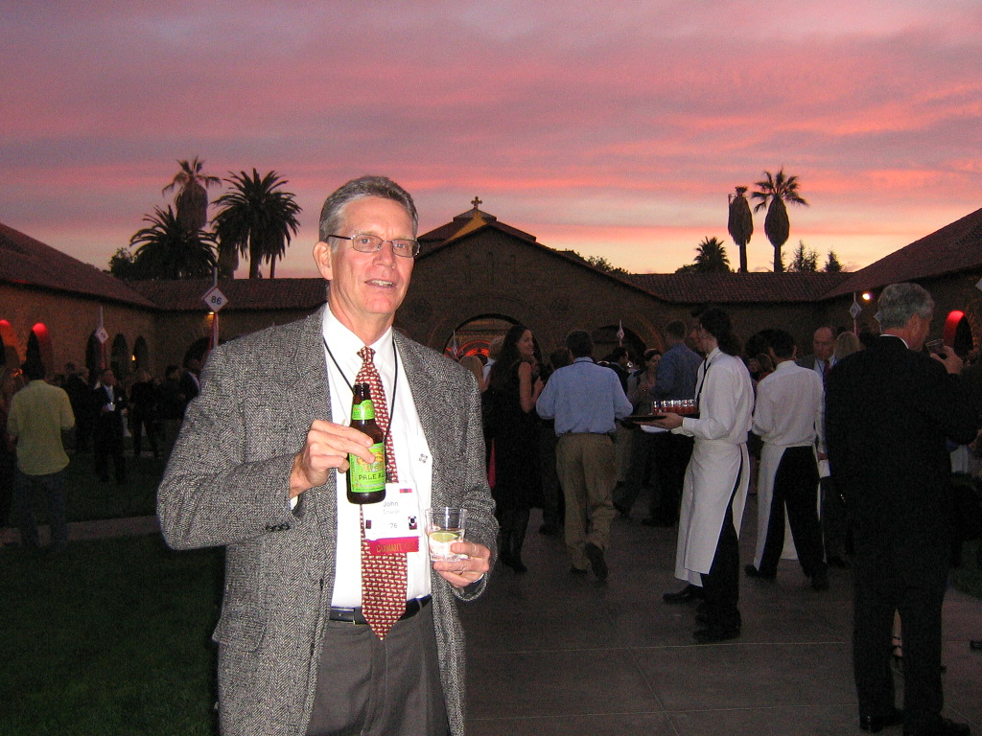

Slide 15


Slide 16


Slide 17

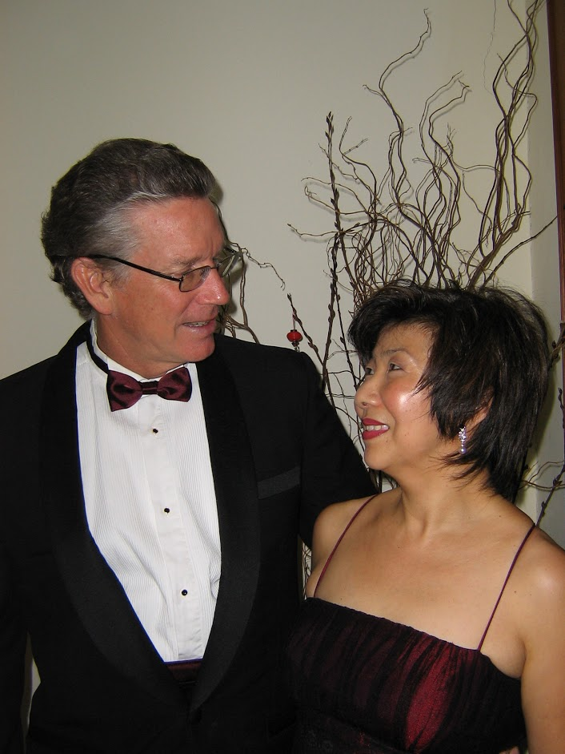
John Driscoll, Founder, Chief Strategist
Nancy Chang Ping-Yean, Director

Slide 18
谢谢
고맙습니다
ありがとうございました
ขอขอบคุณ
Terima kasih
Thank You

